Slide 1

BLOCKCHAINS
ARCHITECTURE, DESIGN AND USE CASES
PRAVEEN JAYACHANDRAN
IBM RESEARCH,
INDIA
SANDIP CHAKRABORTY
COMPUTER SCIENCE AND ENGINEERING,
IIT KHARAGPUR

Slide 2
The ARCHITECTURAL PRINCIPLES
Image courtesy: http://beetfusion.com/

Slide 3
The Blockchain
A Platform for executing transactional services
Spanned over multiple organizations or individuals who may not trust each other
An append-only shared ledger of digitally signed and encrypted transactions replicated across a network of peer nodes

Slide 4
The Block in a Blockchain – Securing Data Cryptographically
Digitally signed and encrypted transactions verified by the peers
Cryptographic security – Ensures that participants can only view information on the ledger that they are authorized to see
Image source: http://dataconomy.com/

Slide 5
Structure of a Block
A block is a container data structure that contains a series of transactions
In Bitcoin: A block may contain more than 500 transactions on average, the average size of a block is around 1 MB (an upper bound proposed by Satoshi Nakamoto in 2010)
May grow up to 8 MB or sometime higher (as of March 2018)
Larger blocks can help in processing large number of transactions in one go.

Slide 6
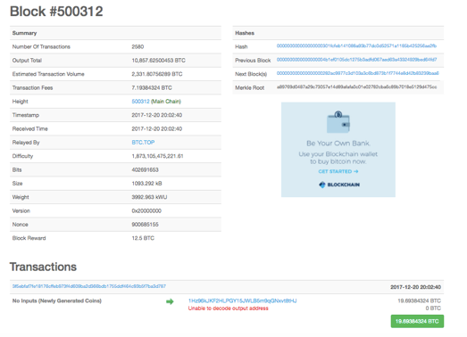
Structure of a Block (Reference: Bitcoin)
Two components:
Block Header
List of Transactions
Block Source: https://blockchain.info/

Slide 7
Block Header (Reference: Bitcoin)
Metadata about a block – (1) Previous block hash, (2) Mining statistics used to construct the block, (3) Merkle tree root
Previous block hash: Every block inherits from the previous block – we use previous block’s hash to create the new block’s hash – make the blockchain tamper proof.
H0
H1 = Hash(H0)
H2 = Hash(H1)
H3 = Hash(H2)
H4 = Hash(H3)

Slide 8
Block Header (Reference: Bitcoin)
Mining – the mechanism to generate the hash
The mechanism needs to be complicated enough, to make the blockchain tamper proof
Bitcoin Mining: H_{k} = Hash(H_{k-1} || T || Nonce)
Find the nonce such that H_{k} has certain predefined complexity (number of zeros at the prefix)
The header contains mining statistics – timestamp, nonce and difficulty
H0
H1 = Hash(H0)
H2 = Hash(H1)
H3 = Hash(H2)
H4 = Hash(H3)

Slide 9
Block Header (Reference: Bitcoin)
Merkle Tree Root: The transactions are organized in a Merkle Tree structure. The root of the Merkle tree is a verification of all the transactions.
Root Hash
H_{root}=Hash(H₀+H₁)
Merkle Root
L₁ Hash
H₀= Hash(H₀₀+H₀₁)
L₁ Hash
H₁=Hash(H₁₀+H₁₁)
L₂ Hash
H₀₀=Hash(T₁)
L₂ Hash
H₀₁=Hash(T₂)
L₂ Hash
H₁₀=Hash(T₃)
L₂ Hash
H₁₁=Hash(T₄)
T₁
T₂
T₃
T₄

Slide 10
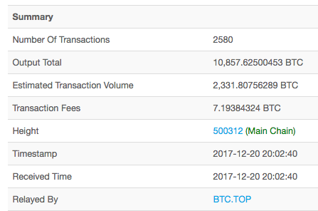
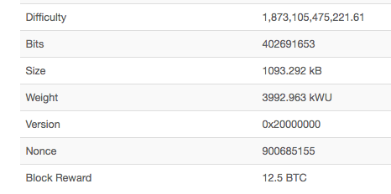
Block Header (Reference: Bitcoin)
Block Source: https://blockchain.info/

Slide 11
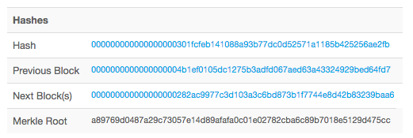
The Hashes in a Block Header (Reference: Bitcoin)
Block identifier – the hash of the current block header (Hash algorithm: Double SHA256)
Previous block hash is used to compute the current block hash

Slide 12
Transactions in a Block (Reference: Bitcoin)
Transactions are organized as a Merkle Tree. The Merkle Root is used to construct the block hash
If you change a transaction, you need to change all the subsequent block hash
The difficulty of the mining algorithm determines the toughness of tampering with a block in a blockchain

Slide 13
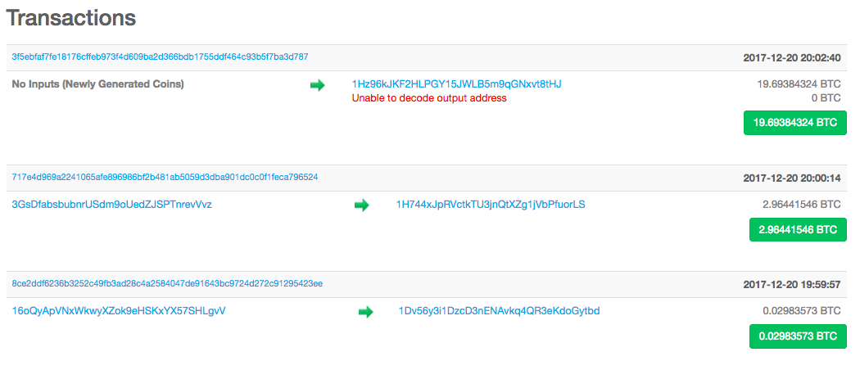
Transactions in a Block (Reference: Bitcoin)
Block Source: https://blockchain.info/

Slide 14
The Block in a Blockchain - Summary
The Block contains two parts – the header and the data (the transactions)
The header of a block connects the transactions – any change in any transaction will result in a change at the block header
The headers of subsequent blocks are connected in a chain – the entire blockchain needs to be updated if you want to make any change anywhere

Slide 15
The Blockchain Replicas
Every peer in a Blockchain network maintains a local copy of the Blockchain.
Requirements
All the replicas need to be updated with the last mined block
All the replicas need to be consistent – the copies of the Blockchain at different peers need to be exactly similar

Slide 16
The Notion of Distributed Consensus
Ensure that different nodes in the network see the same data at nearly the same point of time.
All nodes in the network need to agree or consent on a regular basis, that the data stored by them is the same.
No single point of failure – the data is decentralized
The system can provide service even in the presence of failures

Slide 17
The Notion of Distributed Consensus
Starting from early 90’s a large number of works have been devoted on the development of consensus algorithms over a network
The basic philosophy is based on message passing – inform your current state to others so that everyone can match their current state with others in the network
However, this philosophy requires that the participants in the consensus algorithm knows each other.

Slide 18
The Notion of Distributed Consensus
Can we achieve consensus even when the network is arbitrarily large, and no participant in the network really knew all other participants?
An open network scenario – the permission-less protocol – you do not record your identity while participating in the consensus system
A challenge-response based system – the network would pose a challenge, and each node in the network would attempt to solve the challenge

Slide 19
Challenge-Response to Permission-less Consensus
The challenge-response protocol: The nodes in the network tries to solve the challenge posed by the network
The nodes or the participants do not need to reveal their identity
The node that is able to solve the challenge first, would get to dictate what the next set of data or state elements to be added should be
This will continue iteratively at different rounds

Slide 20
Challenge-Response to Permission-less Consensus
Design of a good challenge – ensures that different nodes will win the challenge at different runs.
This ensures that no node would be able to control the network
The Bitcoin Proof of Work (PoW) algorithm – ensures consensus over a permission-less setting based on challenge-response

Slide 21
The Economics Behind Blockchain Consensus
The challenge-response requires that every node spend large amount of computational power to solve a mathematical challenge in each iteration of consensus.
What is the incentive for nodes? Only one (or sometime a very few of them) will win in each round

Slide 22
The Economics Behind Blockchain Consensus
The Digital Money
Ensures operational efficiency
More levels of controlling monetary policy
1998: Wei Dai published ‘b-money’ – an anonymous distributed cash system
Cryptocurrency – a currency beyond the control of banks and governments

Slide 23
The Economics Behind Blockchain Consensus
The mining ensures that no node has the power to sabotage the network and gain control
No one can hold the control of the cryptocurrency
The computational effort expended by the nodes in achieving consensus would be paid for by cryptocurrency generated and managed by the network
Blockchain ensures that the currency is secure and tamper-proof.

Slide 24
In Summary
The Technology behind Blockchain
The Data Structure – Distributed Ledger
Cryptography and Digital Signatures – Ensure security and tamper-proof architecture
The Consensus over a Permission-less Environment
The Economy of the Revenue Model – Encourages participants to join in the mining procedure

Slide 25
Courtesy for this presentation: ”Why so Delirious about Blockchain? – A Technical View”, by Praveen Jayachandran
Available online: https://www.linkedin.com/pulse/why-so-delirious-blockchain-technical-view-praveen-jayachandran/

